Slide 1
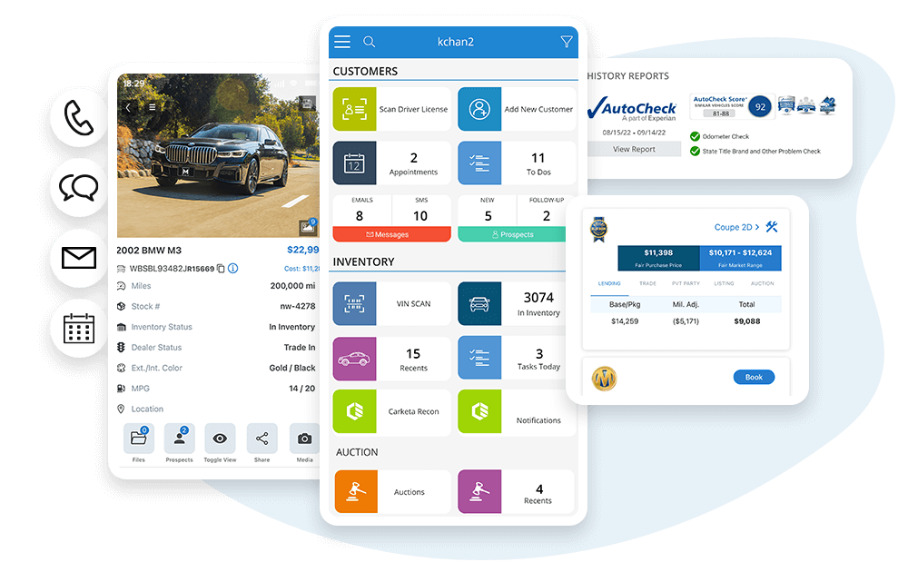
AUTOMIND
Luis Arias
Turning dealership chaos into organized sales power!
Helping small dealers sell smarter, faster, and more efficiently!
Organizing leads, inventory, and deals all in one place!

